Slide 1
Eisenhower Project

Slide 2
Loop Methods Understanding
User can add tasks
Added tasks will sort as Eisenhower matrix
Do it now
Decide when to do
Delegate
Dump it
User can add up to 3 members in a single task
User can add/Edit/Delete multiple members in the list with colour code difference
User can add/edit/delete multiple topics and departments
User can filter task list by clicking on filter.
Q & A
Please clarify User level , What do you meant by user level?
In case of reminder list is on daily/weekly/monthly basis , so in filter we should not provide dates for reminder.
We are assuming User Onboarding is taken by Duende Team.
Do user needs to sign up or login to access application or what is the process to identify users

Slide 3
Sample Wireframes With Detailed Description

Slide 4
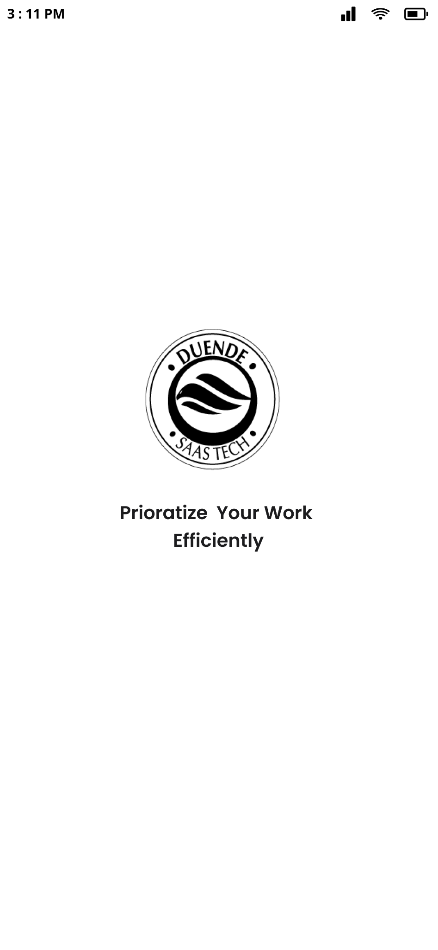
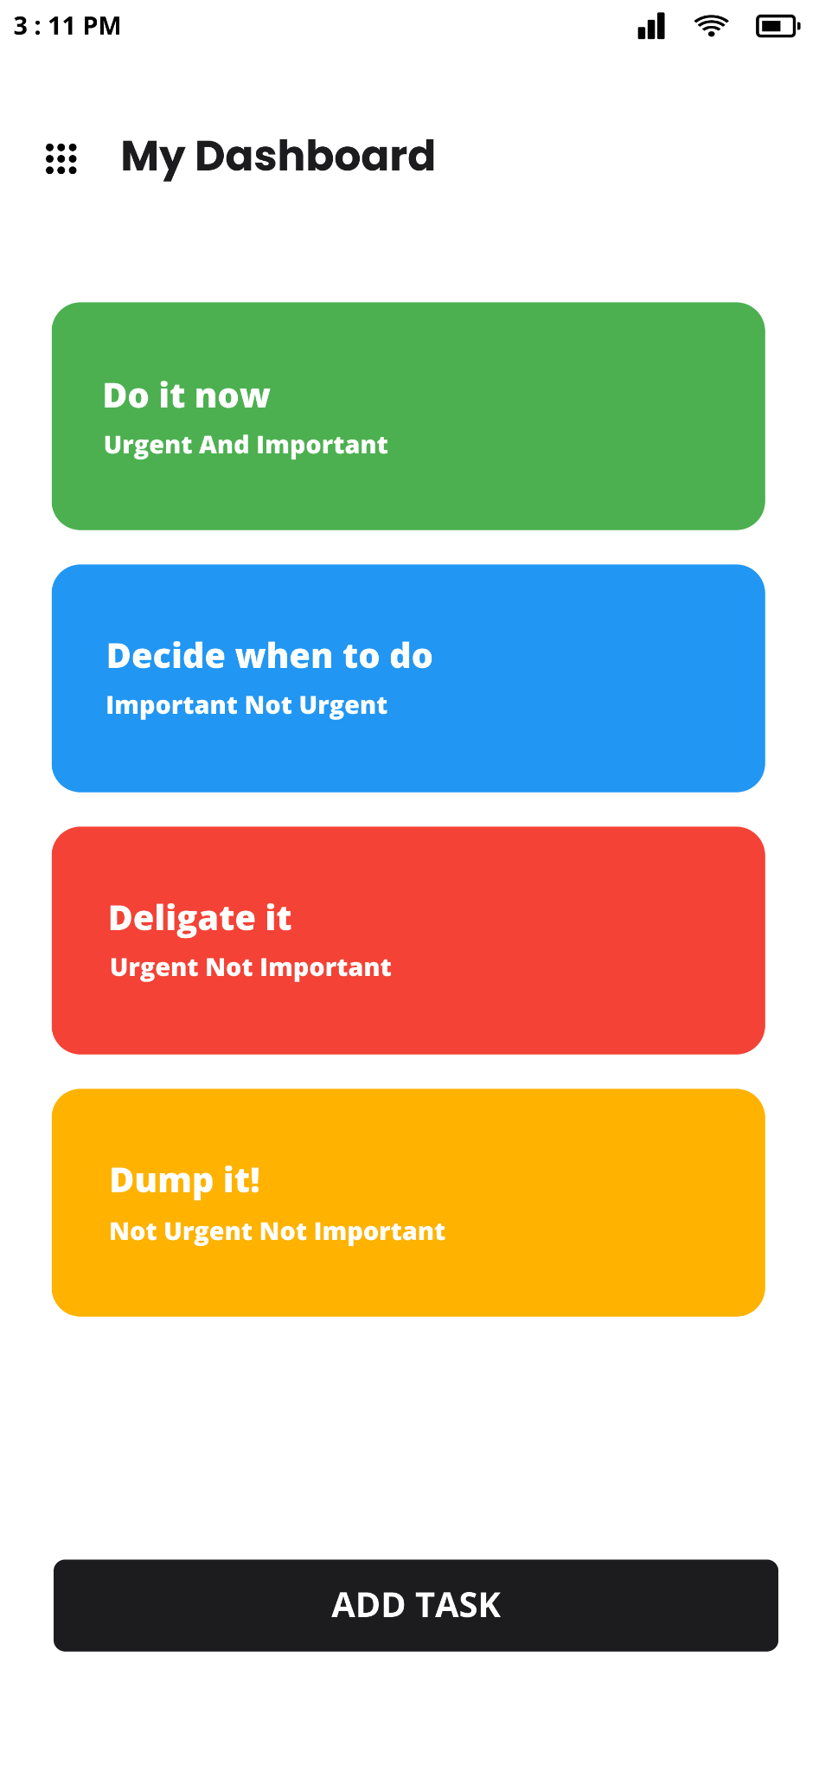
Splash Screen
User will land on this screen after opening application
My Dashboard
After splash screen user will redirect to this screen after few seconds.
On the top there is menu icon
On this screen Eisenhower matrix is implemented with algorithm.
Add Task Button

Slide 5
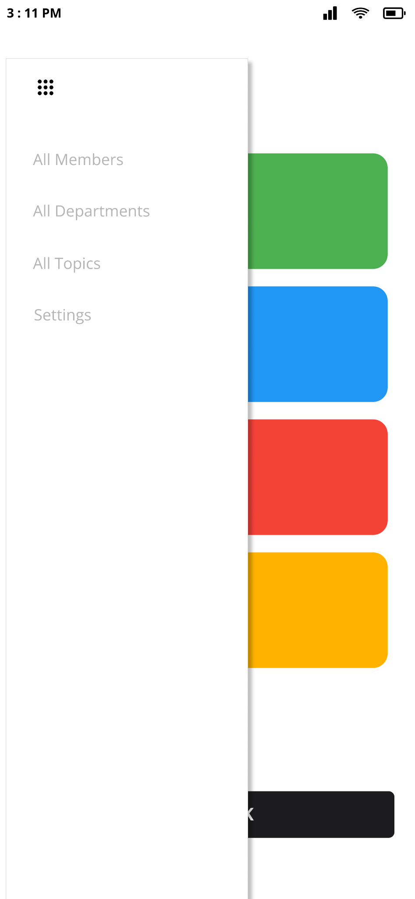
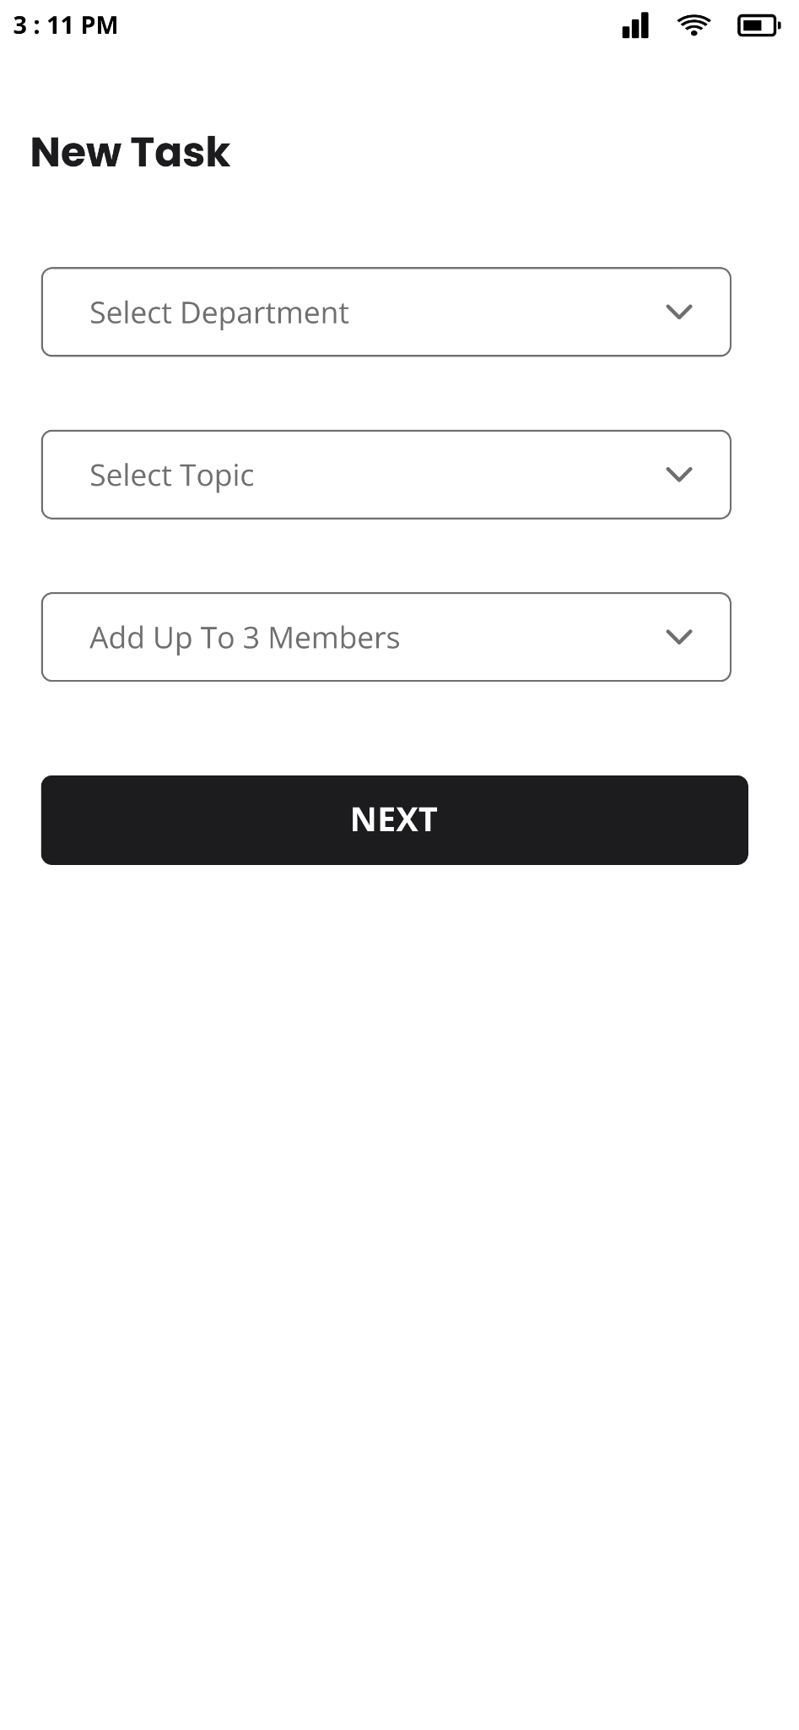
Menu
User clicked on menu icon.
On this menu list
User can see the below data
All Members
All Departments
All Topics
Settings
New Task
User clicked on Add Task
Select Department
Select Topic
Add team members

Slide 6
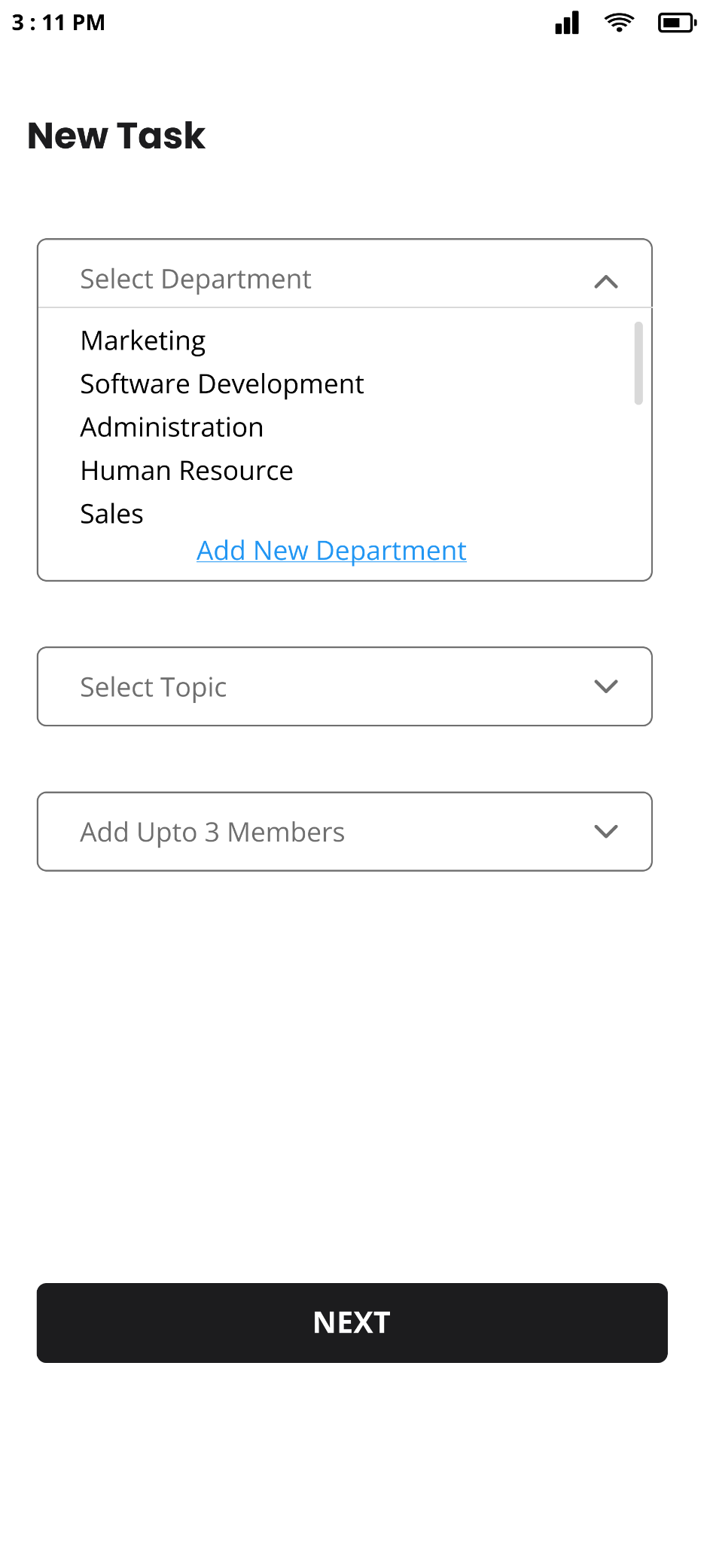
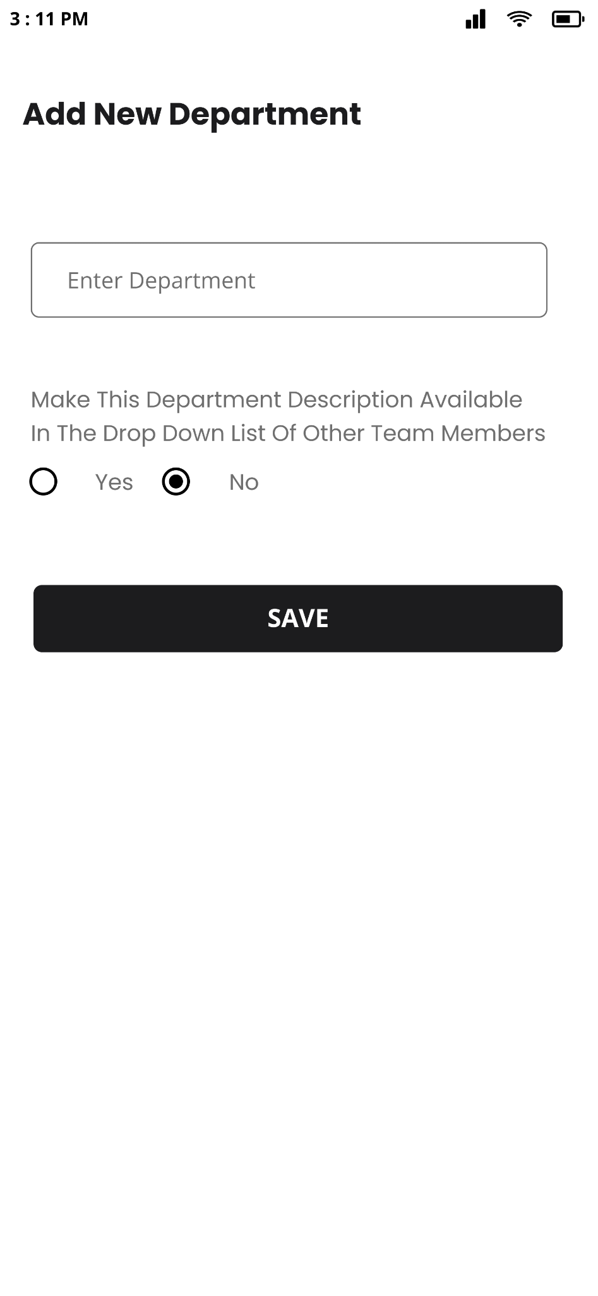
Select Department
User clicked on select department
On this user can select a department or can add new department
Add New Department
User selected add new department
In this user needs to
Enter department
Provide access to other users

Slide 7
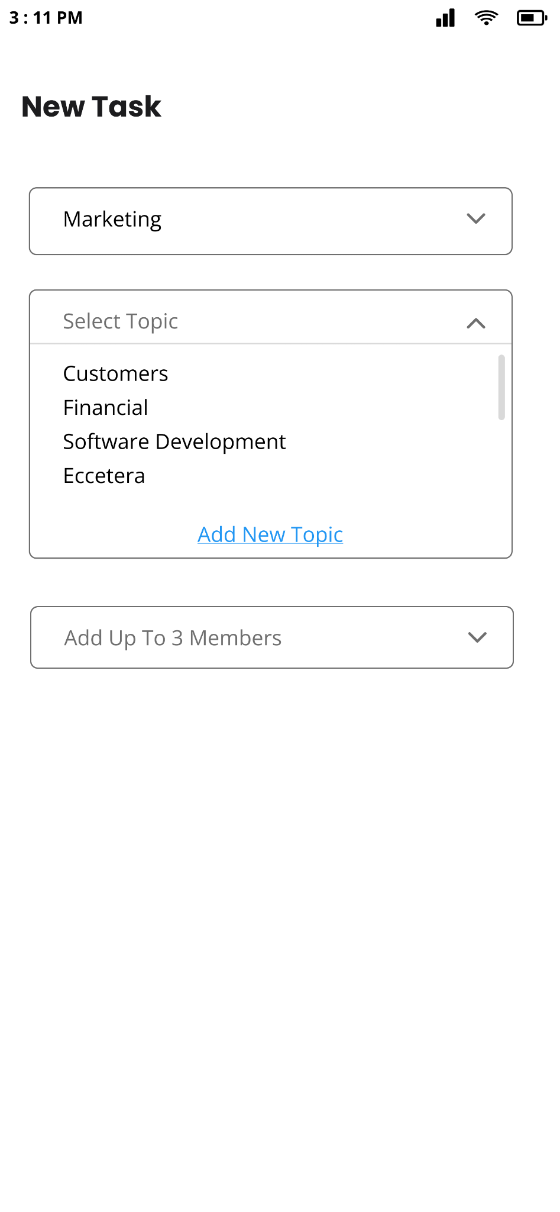
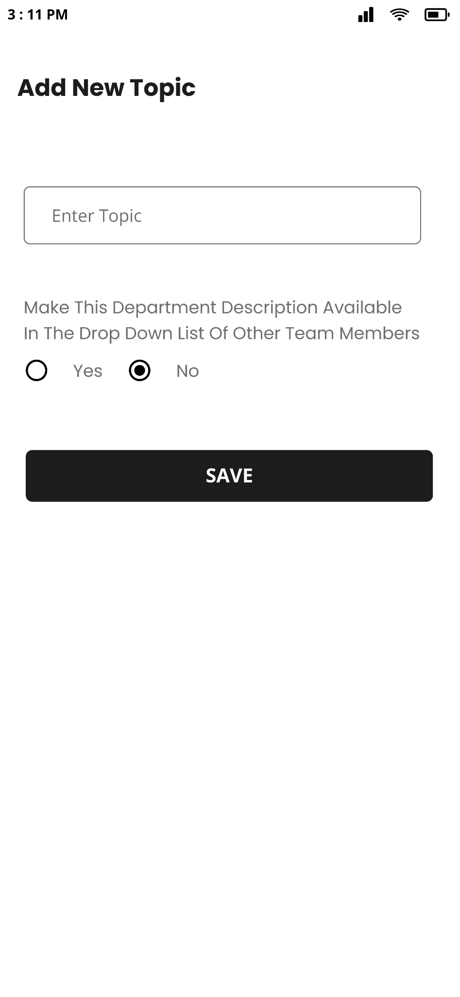
Select Topic
User clicked on select topic
On this user can select a topic or can add new topic
Add New Topic
User selected add new topic
In this user needs to
Enter Topic
Provide access to other users

Slide 8
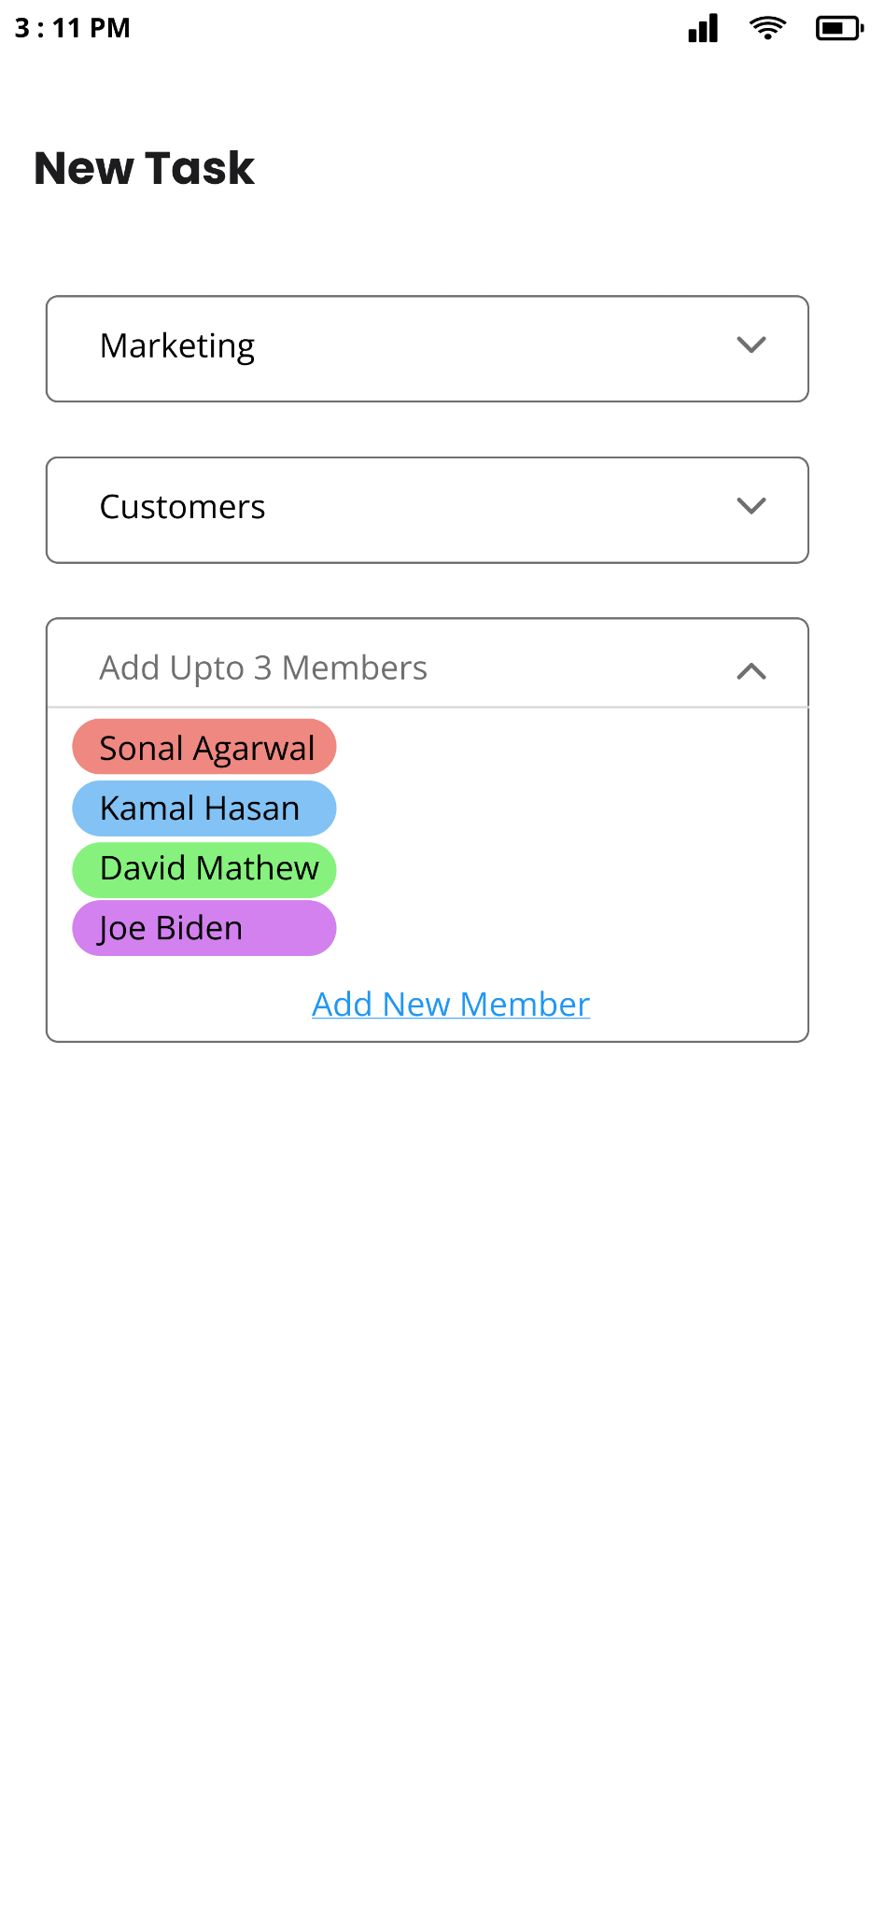
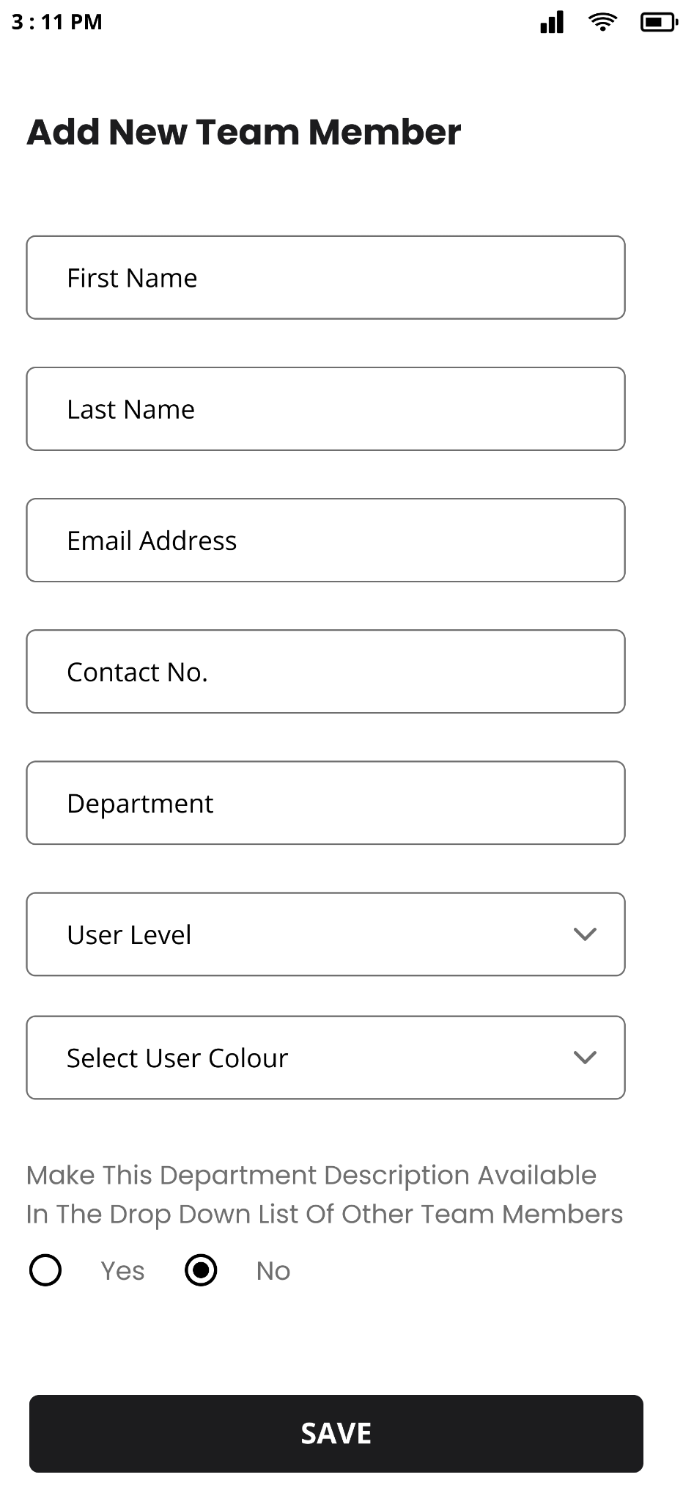
Add up to 3 Members
User clicked on add member
On this user can select 3 members or can add new member in list
Add New Team Member
User selected add new team member
In this user needs to
Enter First & last name
Email Address
Contact no.
Select user level
Select colour code to define users
Provide access to other users

Slide 9
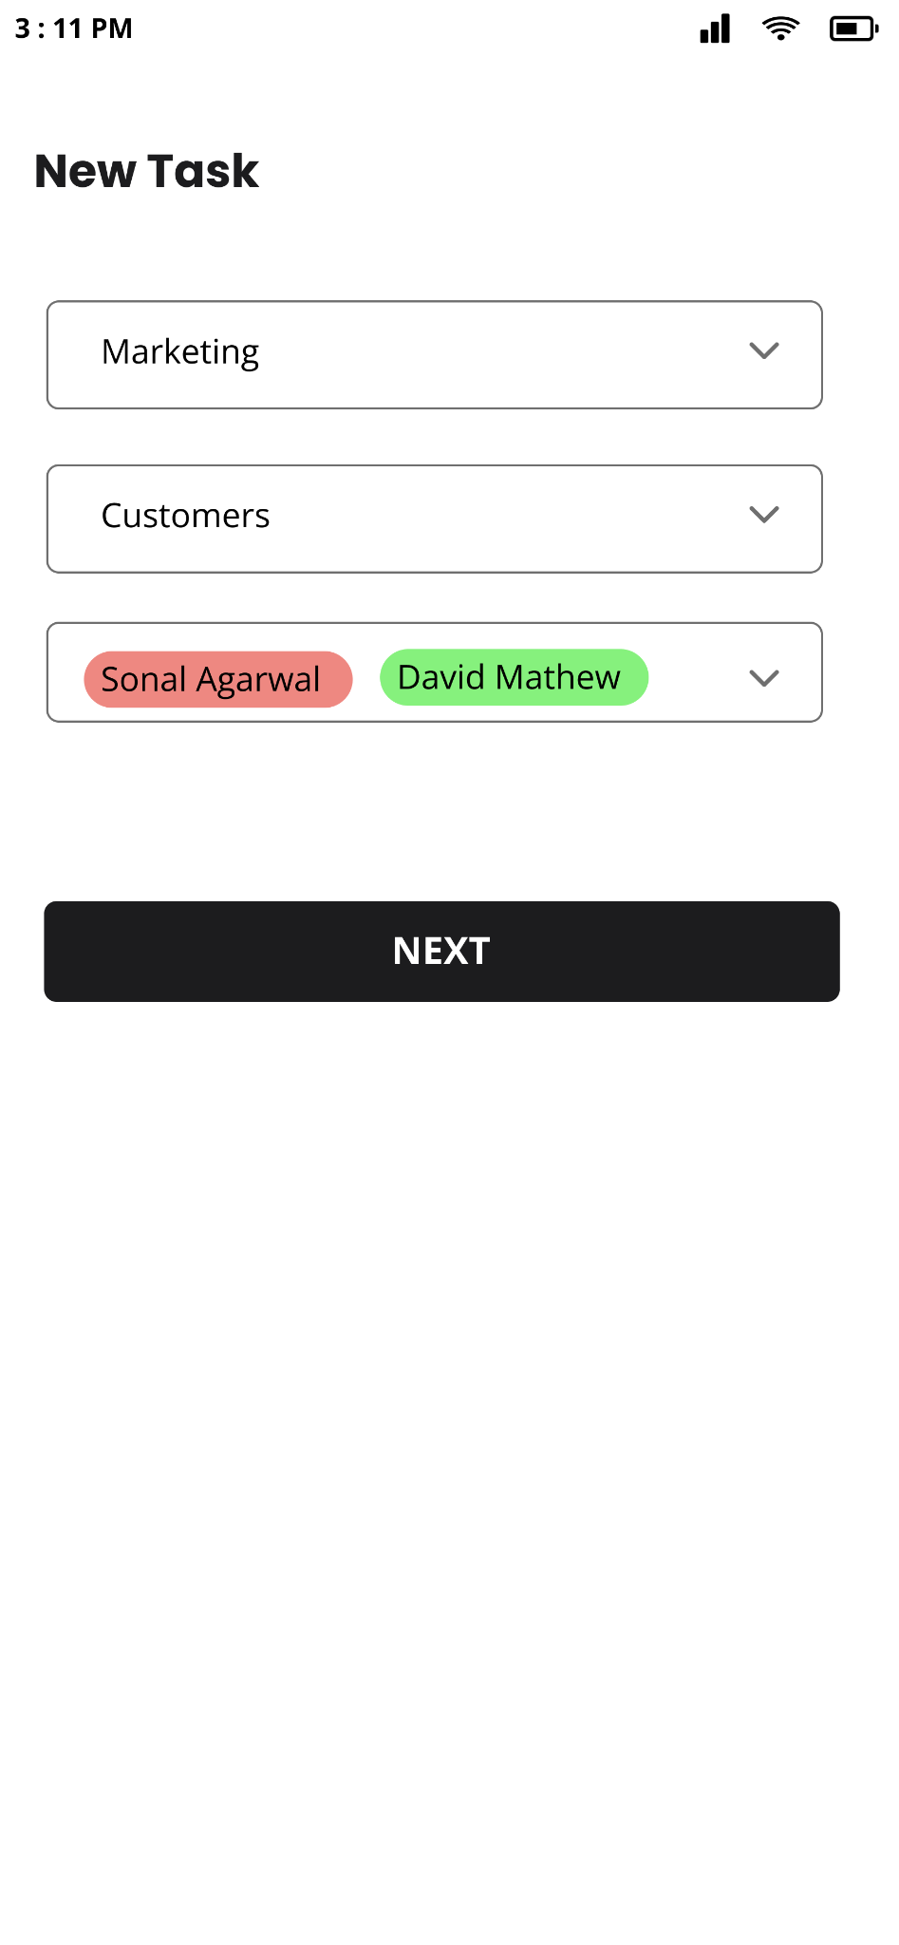
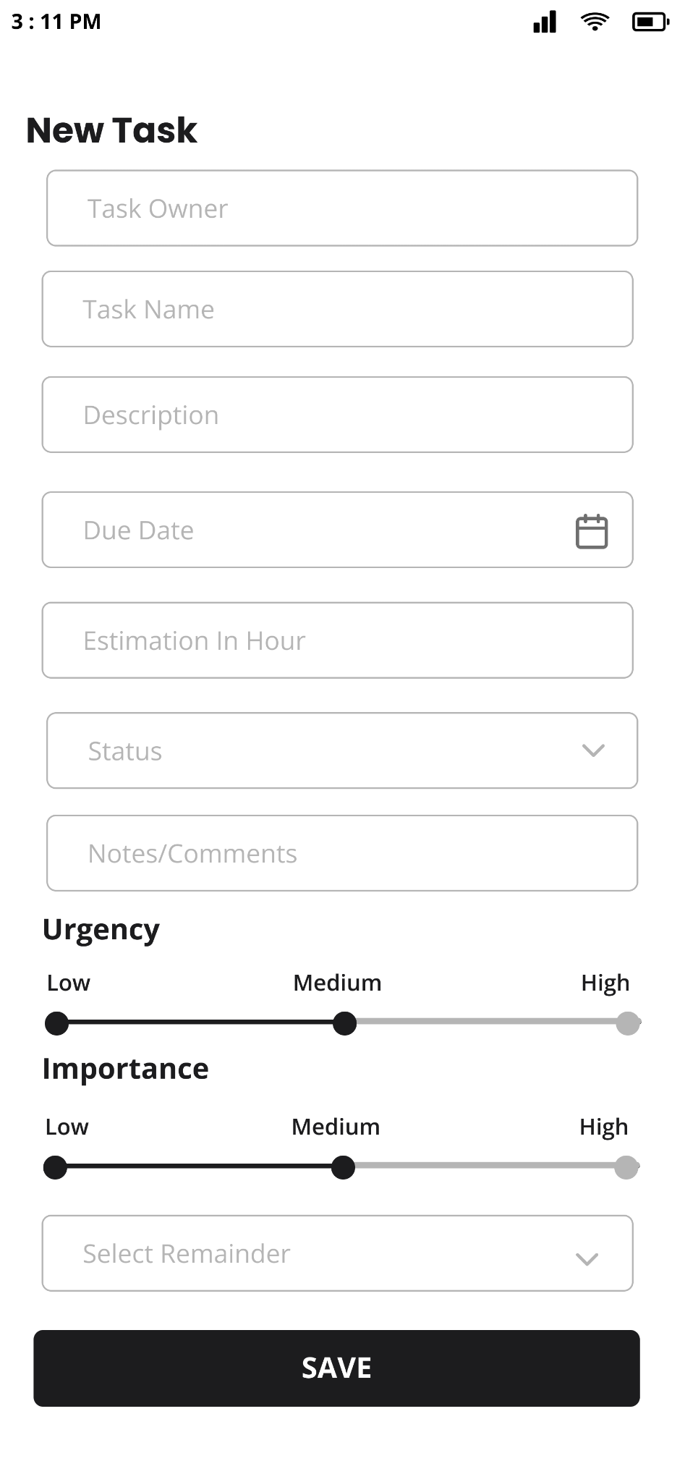
User selected 2 team members to involve in this task
User clicked on next button
Step 2 to add task
In this user needs to
Task owner (autofilled)
Enter task name
Description
Due date
Estimate in hour
Status
Todo
In progress
Done
Notes
Select urgency & importance
Select Reminder

Slide 10
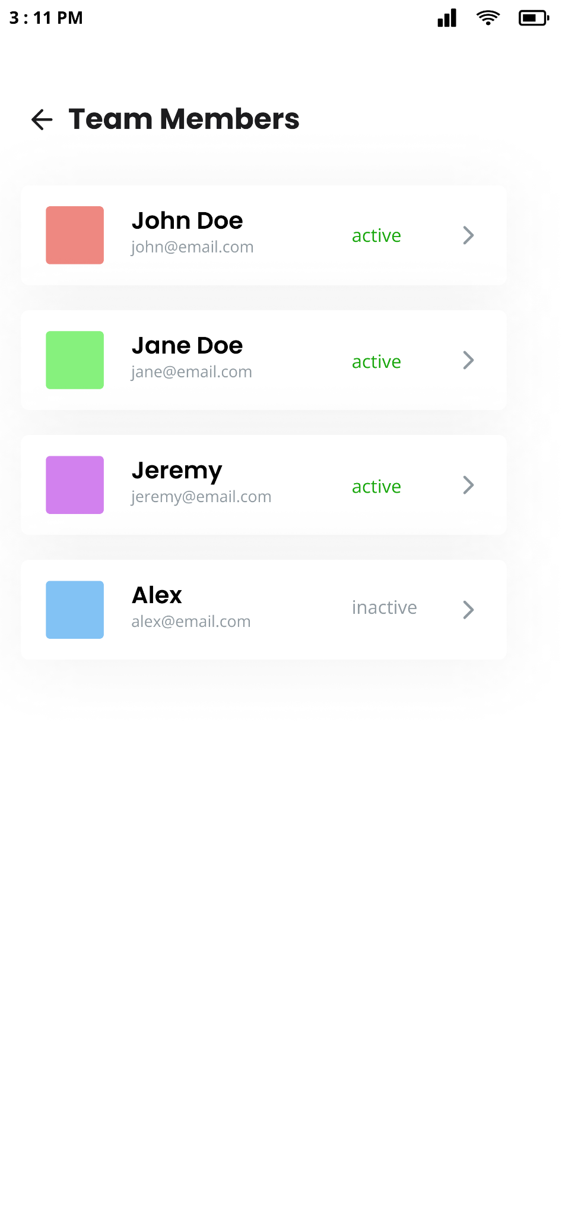
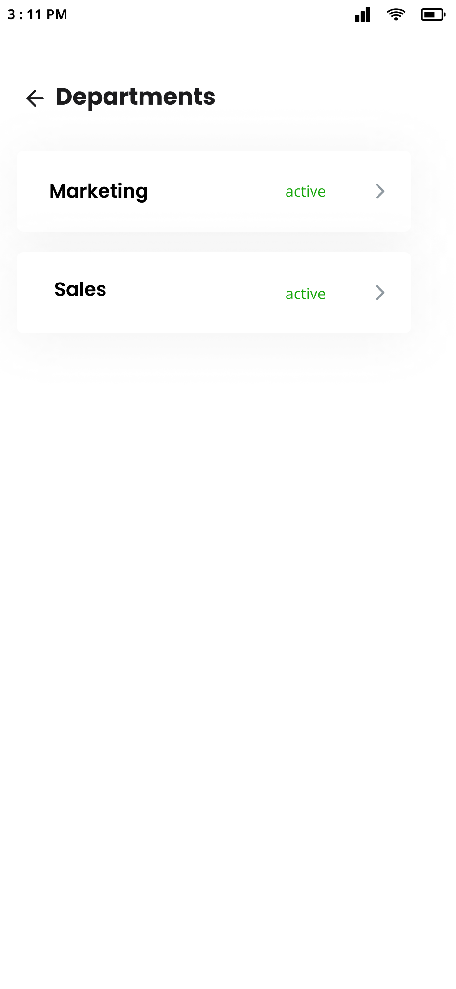
Team Members List
Department List

Slide 11
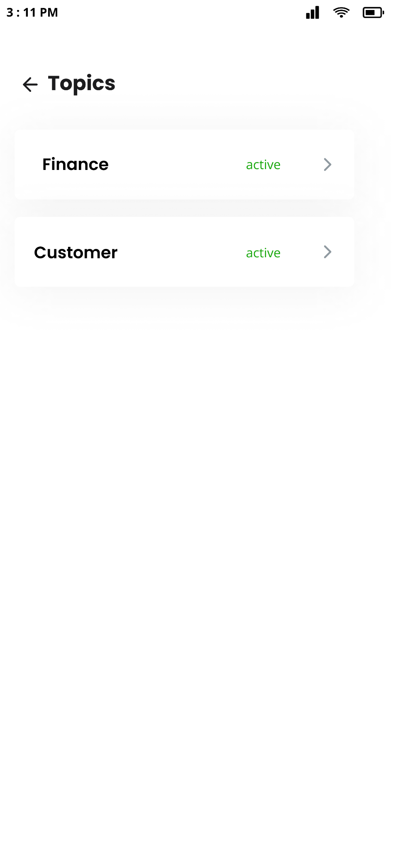
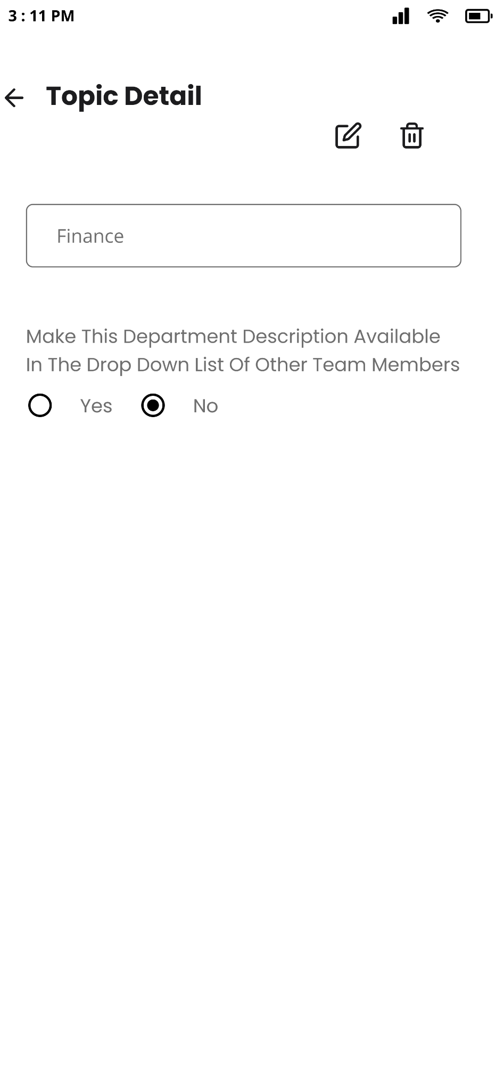
Topic List
Topic Detail with edit/delete functionality

Slide 12
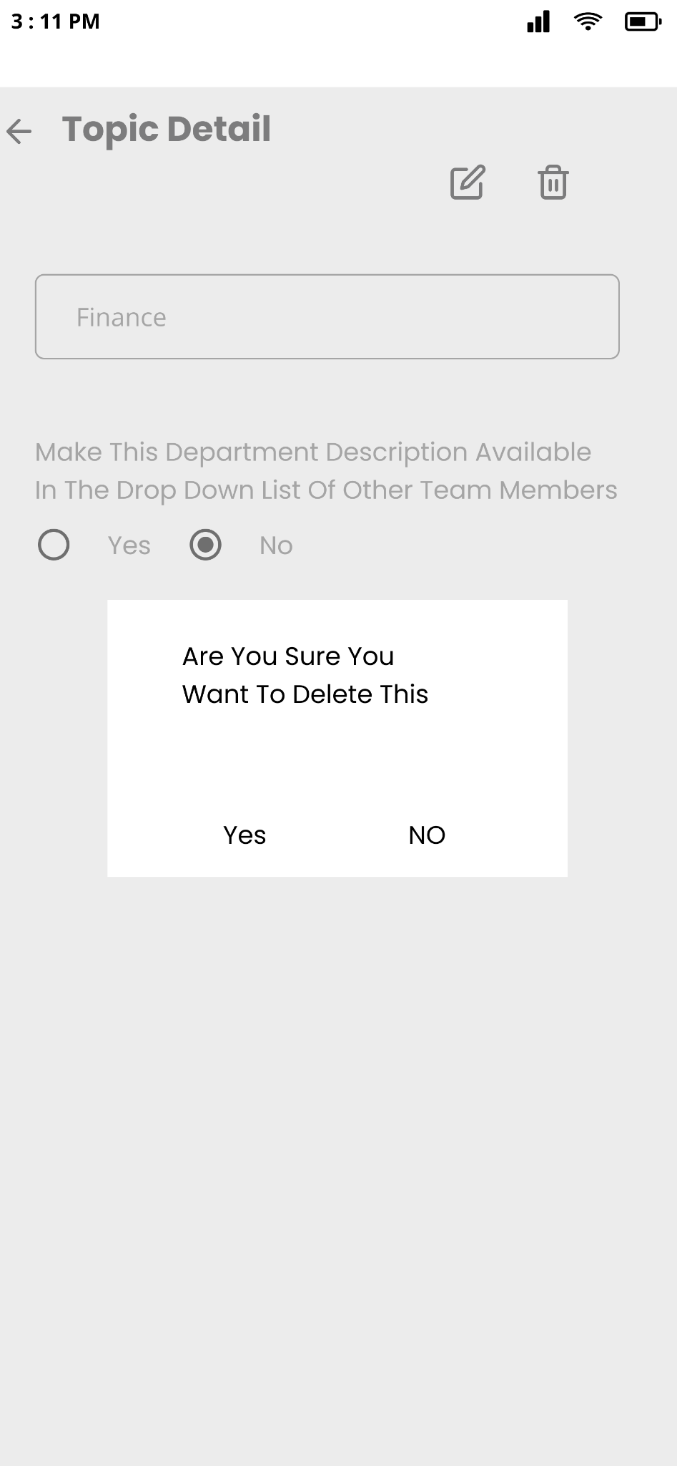
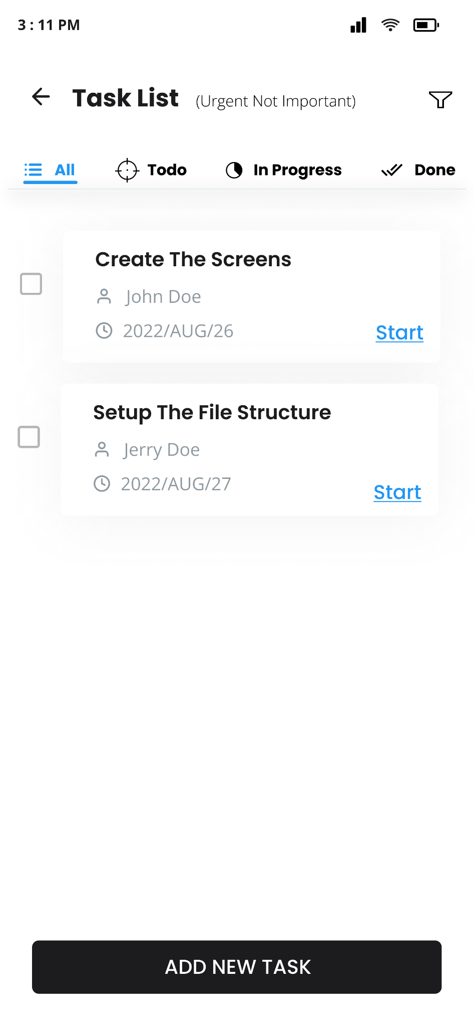
Confirmation before deletion
Task list with status distribution

Slide 13
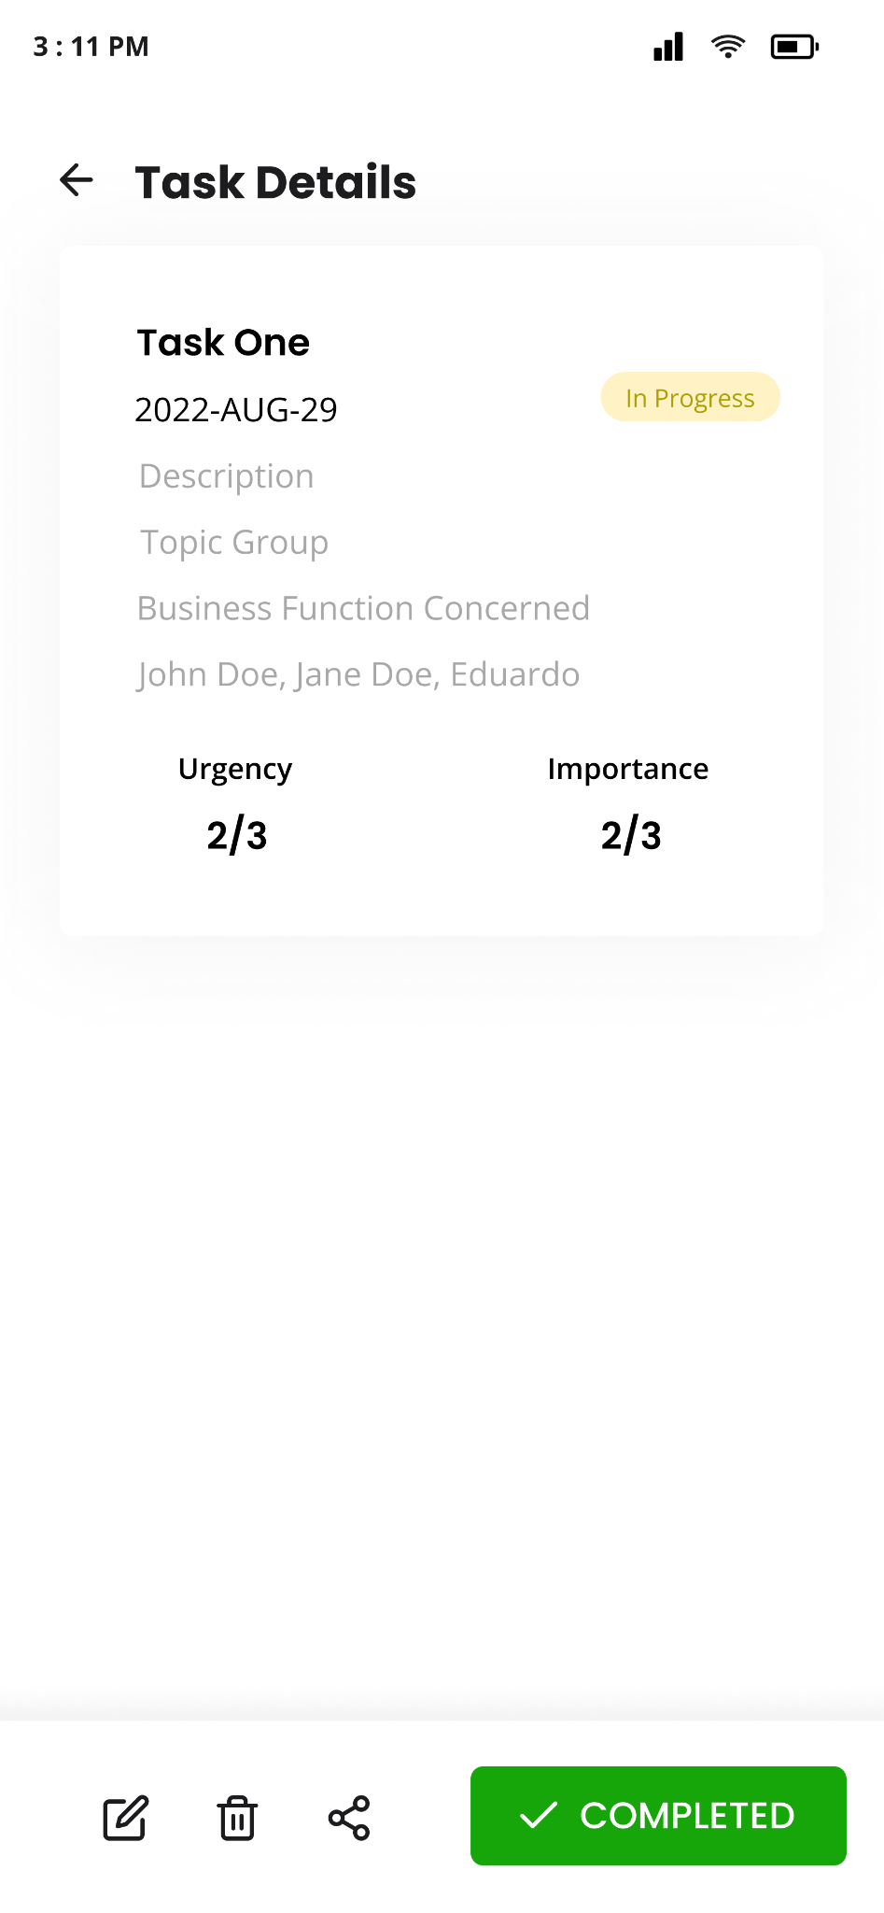
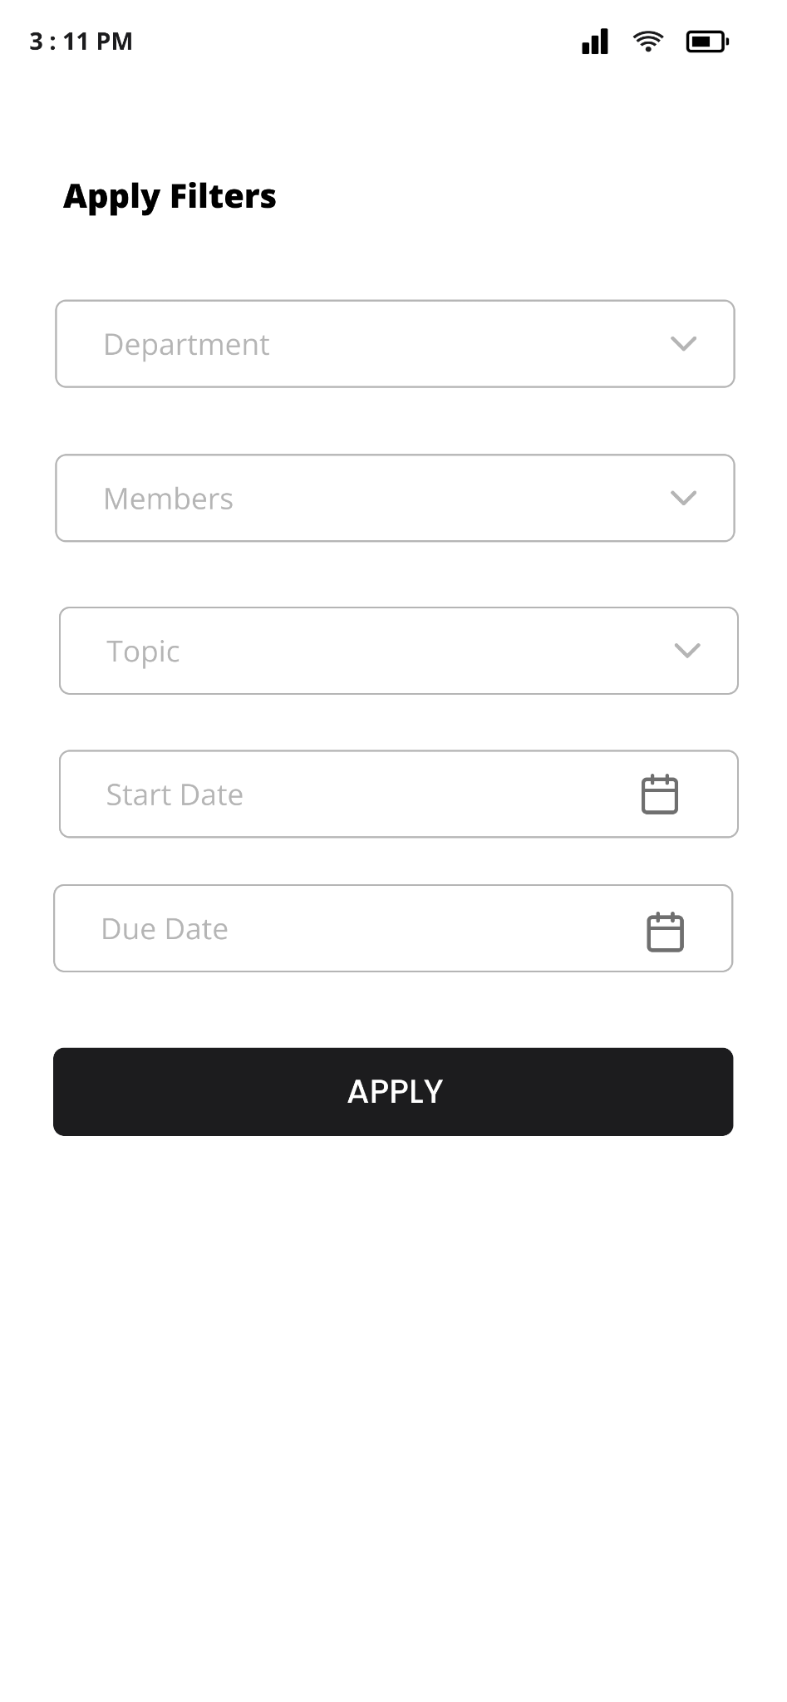
Task Details Screen
Filter Screen

Slide 14
Thank You

